Slide 1


Agroforestry and Agroecological Practices with the Women of Tadjan/TOGO
Presented by:
Mr Meyendou DJALOLE, president of association les Amis de la Planète Vivable
Site web: https://amisdelaplanetevivable.bio
Email: contact@amisdelaplanetevivable.bio
Tél: (+228) 90305309

Slide 2

ABOUT US
01
Our Mission:
Promoting agroecology and conserving natural resources
Our commitment:
Supporting the women of Tadjan through agricultural groups

Slide 3
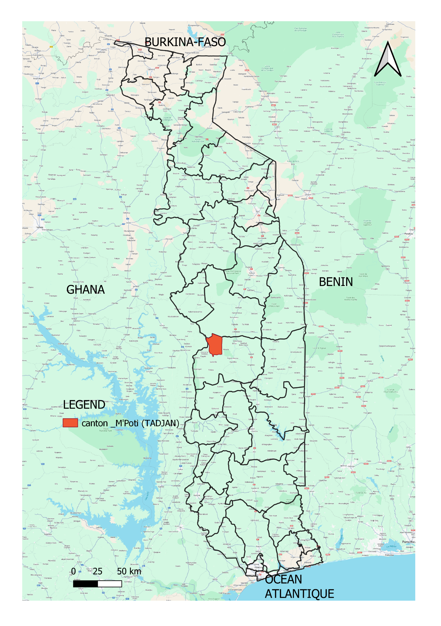
Context and challenges
Challenges
Déforestation
Unsustainable land use
Biodiversity loss
Goal
Restore soils and promote sustainable agroforestry practices with local communities
02

Slide 4
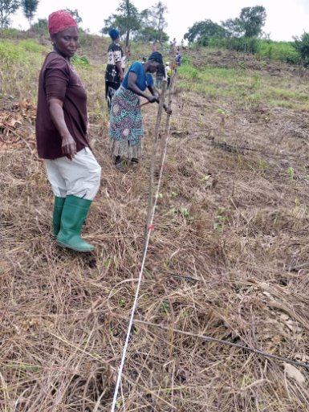
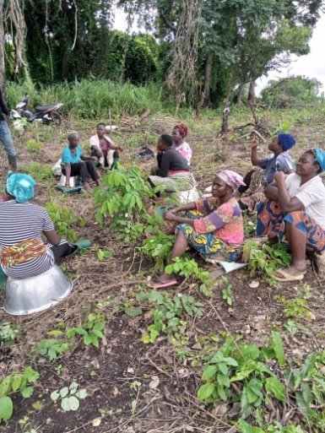
Organization of Agricultural Groups
Creation of women’s agricultural groups in Tadjan
Support Provided
● continuous training on agroecological practices
● awareness on environmental protection
● financial incentives to support local initiatives
03

Slide 5
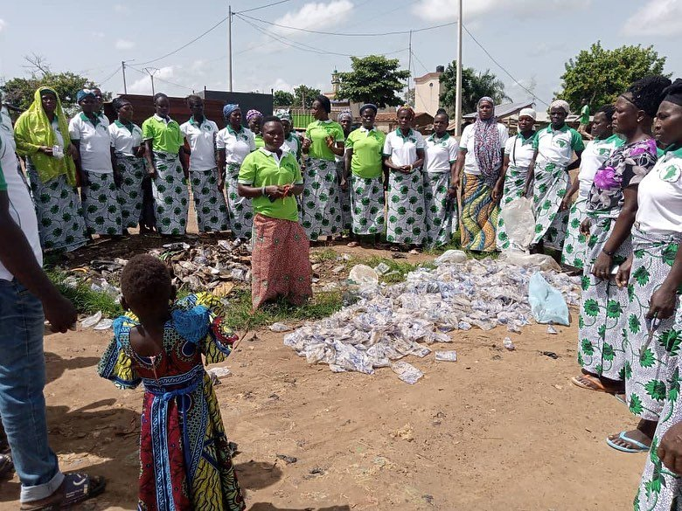
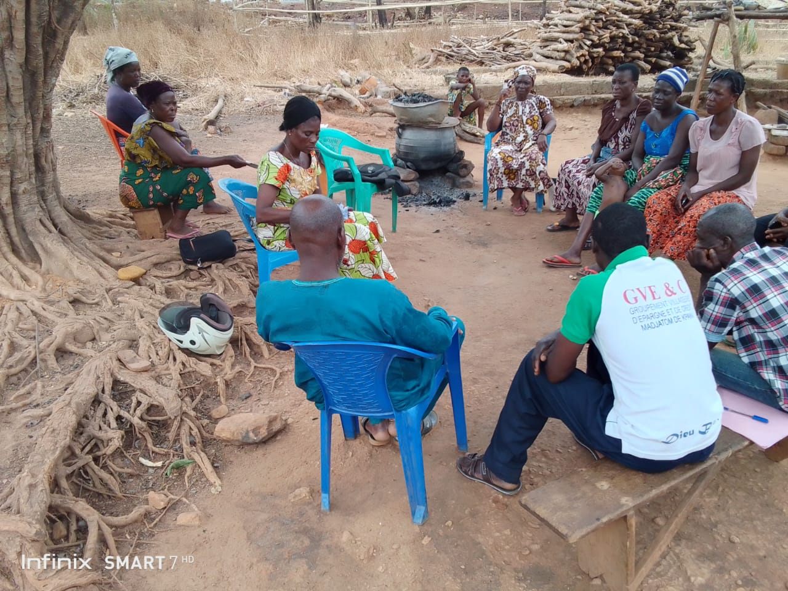
Training and awareness
Training topics covered:
Environmental protection
Nursery production techniques: species selection, soil preparation, potting, seeding
Sustainable water management (watering of plants)
04

Slide 6
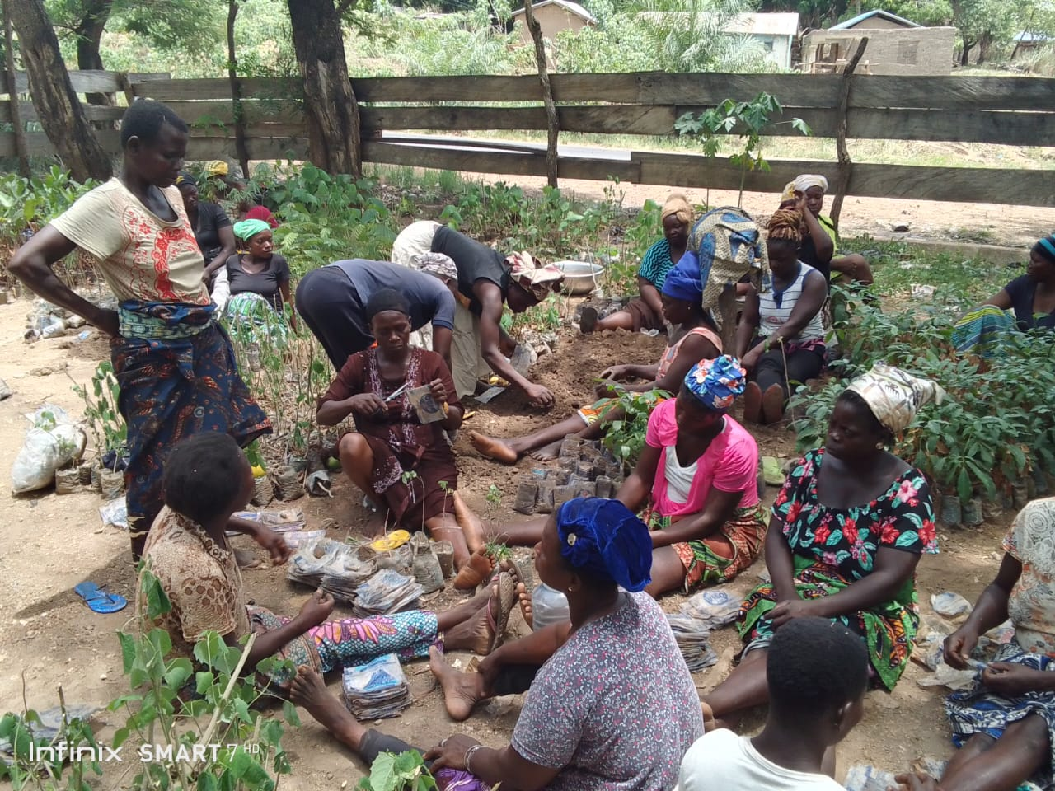
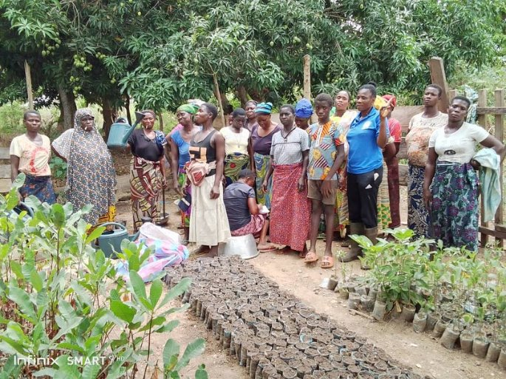
Implementation of Nursery
Nursery activities:
Site selection for the nursery and choosing the species
Preparation of pots and direct seeding
Regular monitoring and watering to ensure healthy plant growth
05

Slide 7
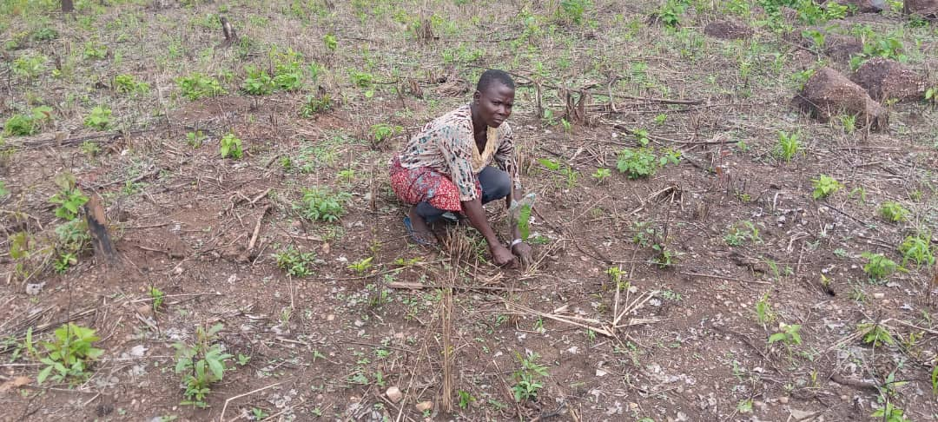
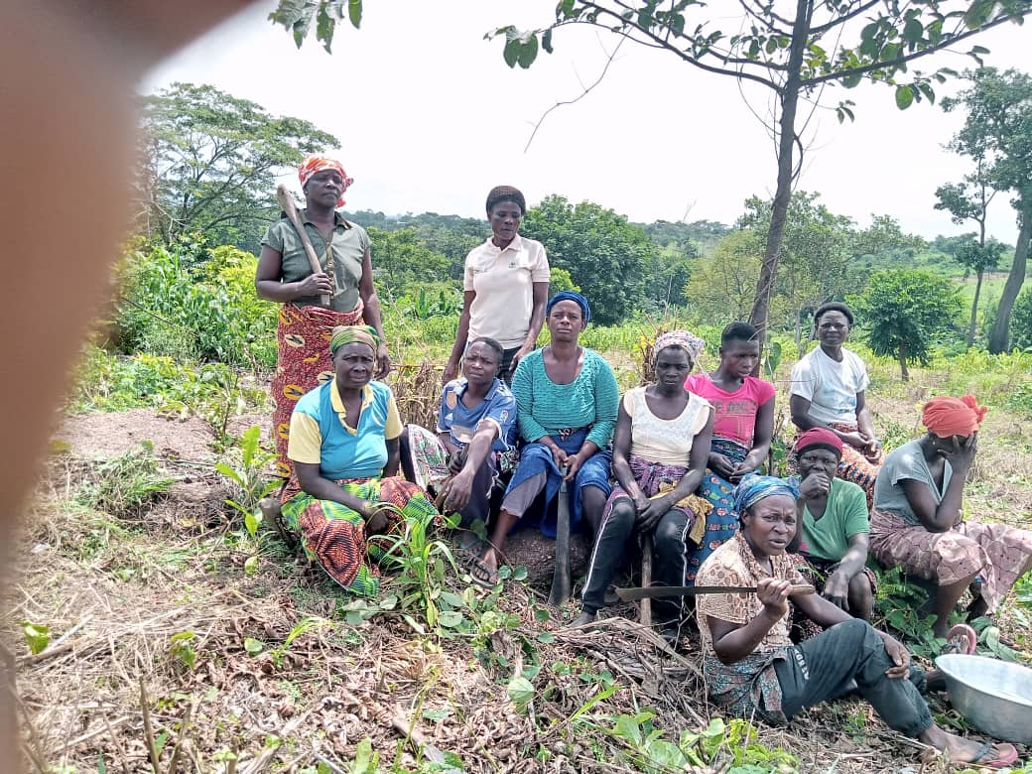
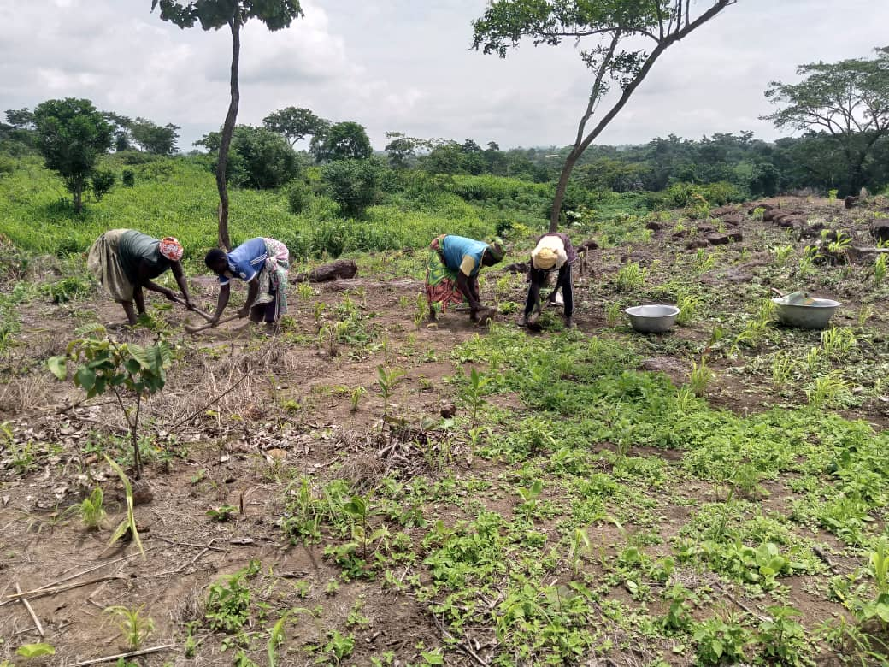
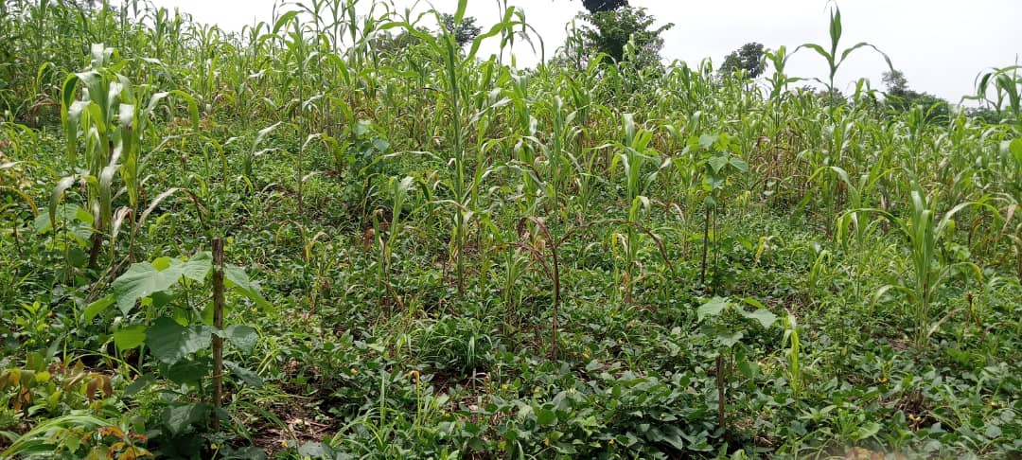
Agroecological Management of Fields
Agroforestry: Integrating trees within fields to combine farming and conservation
Principles applied:
Soil protection and increased biodiversity
Reducing the use of pesticides
Creating firebreaks to protect against bushfires
06

Slide 8
Results and Impact
RESULTS
01
02
03
Improved soil quality and regeneration of local vegetation
Empowerment of women through agroecological practices
Increased resilience to climate change
07

Slide 9
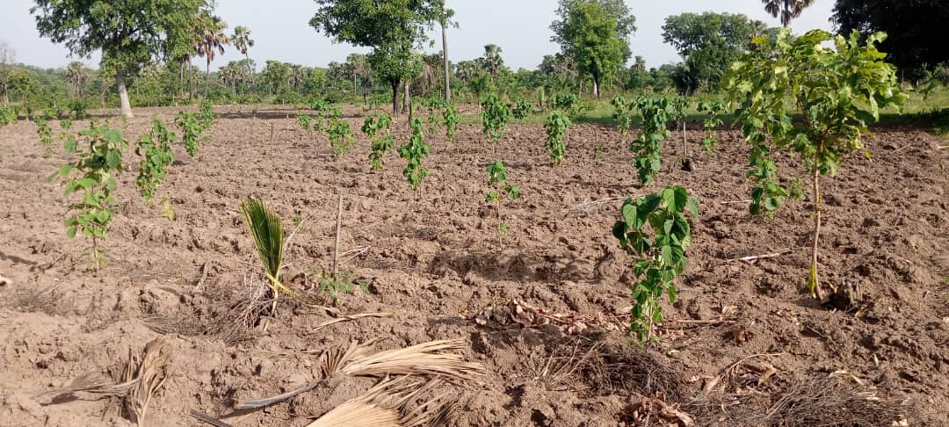
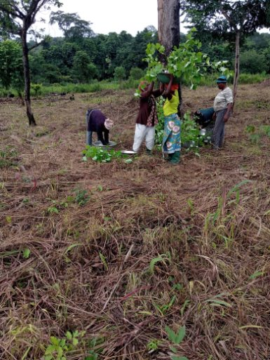
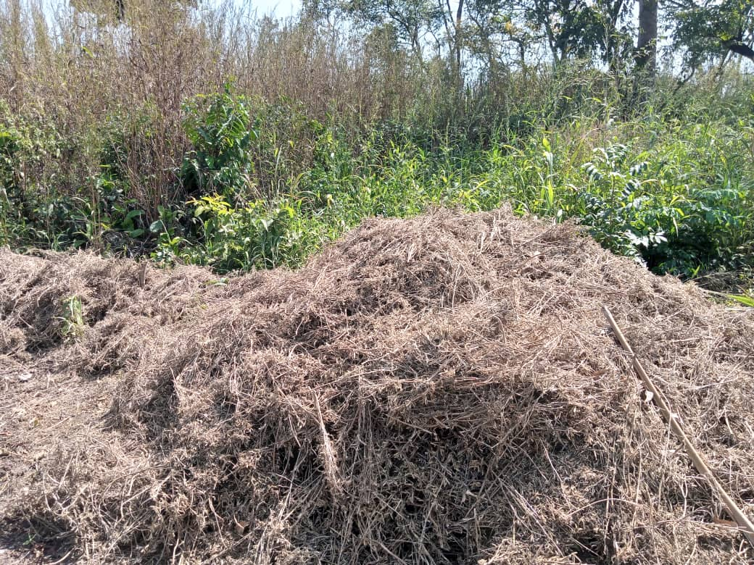
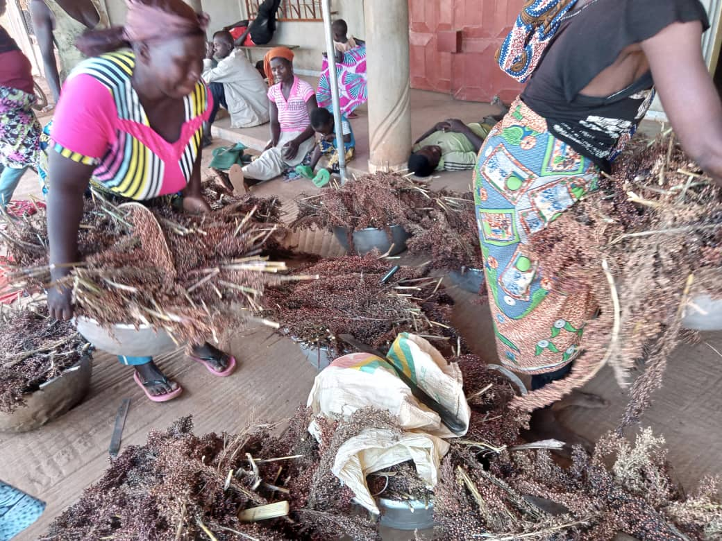
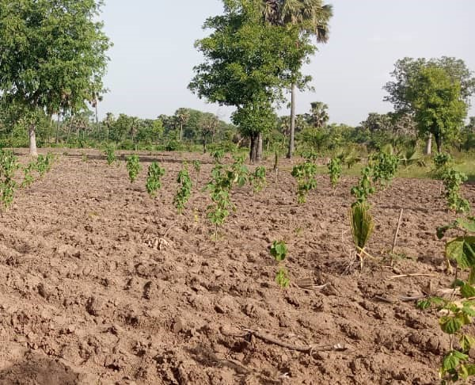
Testimonials and images
Testimonials from participants and visible results on the ground

Slide 10
Conclusion and Future Perspectives
Summary
Agroecological practices benefiting both the environment and local communities
Successful collaboration with the women of Tadjan for lasting impact
Future Perspectives:
Expanding the project to other villages
Continuing partnerships to finance and support reforestation initiatives

Slide 11


Funded by

Slide 12


Funded by

Slide 13
THANK YOU FOR WATCHING

